Slide 1
Moving Beyond Open Rates
TACCM 2024
jdblundell.github.io/beyond-open-rates

Slide 2
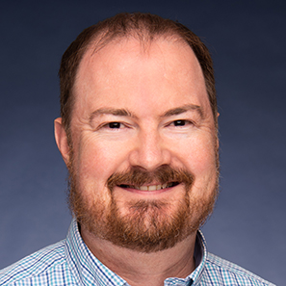
About Me
Jonathan Blundell
Senior Director, Digital Experience
Dallas College
jblundell@dallascollege.edu
linkedin.com/in/jdblundell/
TACCM.org/Slack
I’m Hiring

Slide 3
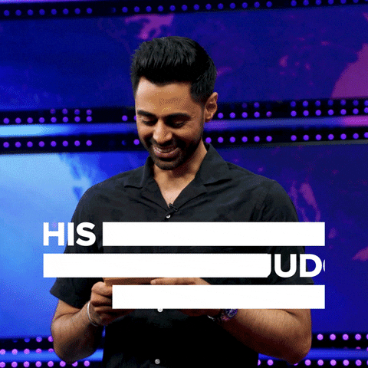
Judgement Free Zone
“The biggest room in the house, is the room for improvement.”
- Dr. Wright Lassiter, Jr. Former DCCCD Chancellor

Slide 4
Getting Started
How do you define email marketing?
What kind of emails does your marketing department send?
Who has a dedicated staff member to email?
On a scale of 1-5, how would you rank email marketing as a priority for your college?
Notes:
Email marketing = sending emails to a list of subscribers to promote products, services, or your brand; used to build relationships with your current/future customers

Slide 5
What’s A Good Open Rate?
What’s your baseline for open rates?
All Users: 18%
Education: 24.9%
Data from Campaign Monitor
Notes:
Pulling the last six months –
Overall open rates 29.69%
Overall CTR 3.41%
Employees – 21.26%; 2.92%
Current Students – 19.25%; 2.41% - includes our newsletters; we’ve seen a sizeable drop in the last 18 months when we switched to using Dallas College email addresses
Registration – 35.78%; 4.6%
Automation Future Students – 65.77%; 7.37%

Slide 6
Rates May Vary
Dallas Overall Open Rates – 29.69%
Employees – 21.26%
Current Students – 19.25%
Student Services – 25.61%
Registration Emails – 35.78%
Automation Future Students – 65.77%
Jan. 1-June 2, 2024
Notes:
Pulling the last six months –
Overall open rates 29.69%
Overall CTR 3.41%
Employees – 21.26%; 2.92%
Current Students – 19.25%; 2.41% - includes our newsletters; we’ve seen a sizeable drop in the last 18 months when we switched to using Dallas College email addresses
Student Services – 25.61%; 2.62%
Registration – 35.78%; 4.6%
Automation Future Students – 65.77%; 7.37% - sending to roughly 1000 students a month

Slide 7
By the Numbers
What’s your baseline for unsubscribes?
All Users: .1%
Education: .1%
Data from Campaign Monitor
Notes:
Dallas
Bounce rate .84%

Slide 8
Why Email Marketing (Still) Matters

Slide 9
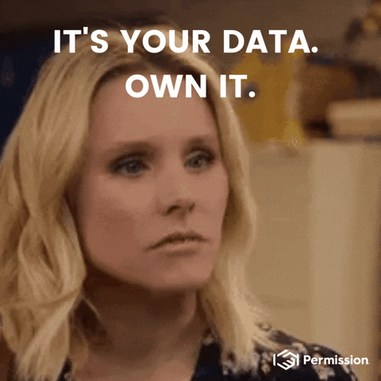
Email is First-Person Data
You own it.
Notes:
In our new digital marketing world, cookies are less and less valuable, depending on Facebook algorithms are less valuable.
Email is data you own and you maintain. You can build from current students, future students, parents, alumni, community members and keep growing what you know about every individual in a CRM or similar platforms.
If you offer summer camps at your college, get the kids info and get an email address from one or both parents – they may be interested in taking classes or there may be an older kid that is looking to take classes … or in 5 years or so that kid in summer camp may be ready to consider college.

Slide 10
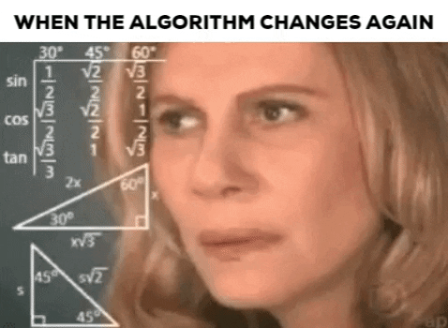
It’s Direct and Immediate
If you do it right, there’s no algorithm blocking you.
Notes:
Something that annoys me a lot is when I see a Facebook post for an event that happened two days ago. You can’t control the algorithms on so many platforms but unless you start getting flagged for black hat practices or spam, you have a direct, immediate access to an individual’s inbox.

Slide 11
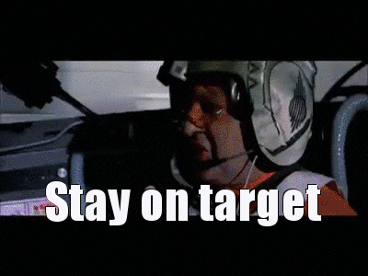
Targeting is Simple
… and based on your data.
Notes:
All that data you’re gathering lets you be specific in who you talk to and what you talk about. Take the time to think about your lists and target your messages correctly.

Slide 12

People Still Engage With Emails
It’s often one of the first things people check in the morning.
Notes:
If you’re wanting to hit community members, sending an email early in the morning is often a great time as they check their email before work and you can often catch them before they’re flooded with other emails.

Slide 13
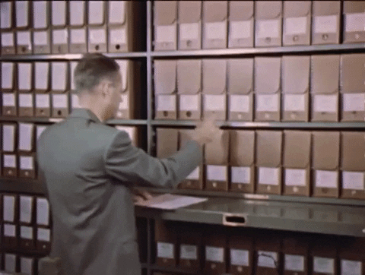
Emails Have a Long Tail
People store all sorts of info in their inbox for years.
Notes:
We have a 180 day expiration on our email links now because we started receiving too many complaints that people were trying to click in older emails and couldn’t view the content.
Looking at my stats the other day, I saw someone came to our website from an email we sent in 2022.

Slide 14
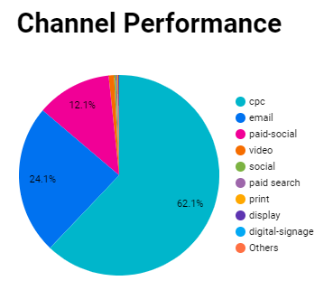
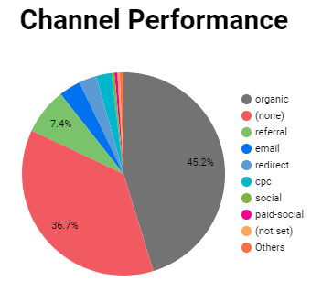
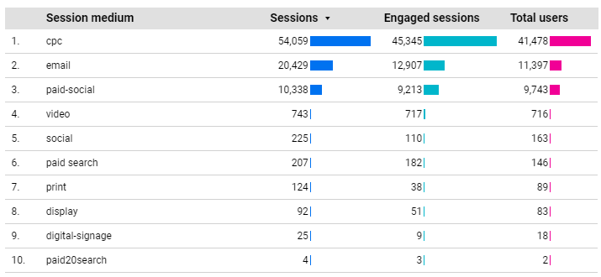
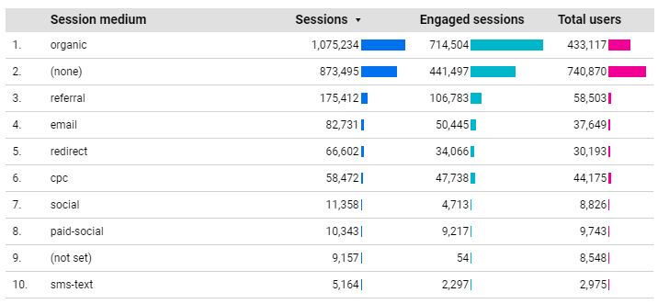
Email Remains A Top Performer
Notes:
For our fall campaign .. Email is our number two performing channel to drive traffic to our website – behind paid CPC.
For our overall web traffic during the same time frame, it’s number 4, behind organic, (none) and referral traffic. It’s organic – free and driving lots of traffic to our site every day.

Slide 15
What About Open Rates?

Slide 16
How Open Rates Are Measured
Emails Opened
Emails Sent
Emails Bounced
Emails Opened/Emails Delivered = Open Rate

Slide 17
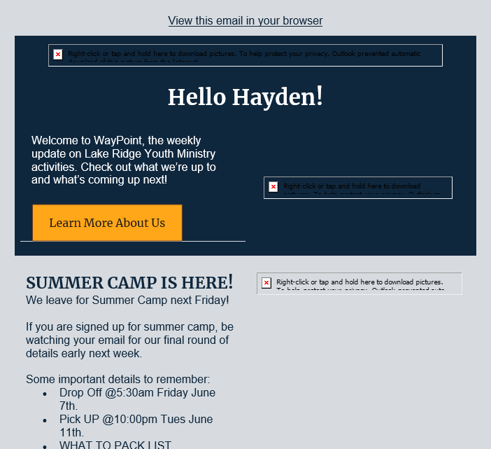
No Images = No Tracking
Those with images turned off likely won’t count.
Text-only emails likely won’t track.
Notes:
By default – Outlook/Microsoft won’t load images of unknown email senders

Slide 18
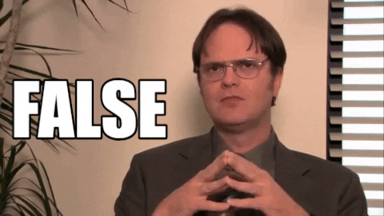
False Opens
Some email clients automatically download images, and this could count as a false open.
Google has been triggering false opens since May 2018.

Slide 19

The Rules Keep Changing
Apple’s Mail Privacy Protection (Sept. 2021) disables open rates for users who have opted in.
Notes:
As a consumer I love this … as a marketer I hate it
Of note … open rates on Apple Mail clients may be inflated not lowered

Slide 20
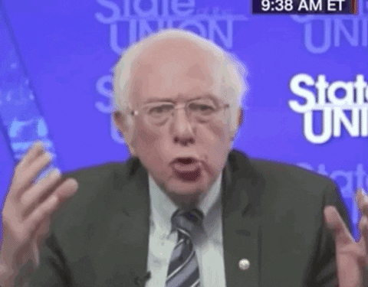
Open Rates Don’t Show Action
Notes:
What do we really know from an open rate? We know that some images loaded in their email and they may have skimmed the content or looked at the opening sentence. Our goal as marketers is to drive action … so an open rate doesn’t tell us anything about any actions they took.

Slide 21
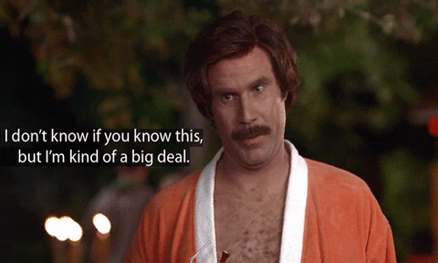
Open Rate = Vanity Metric
Open rates make you look good to others but doesn’t help you understand your performance in meaningful ways.

Slide 22
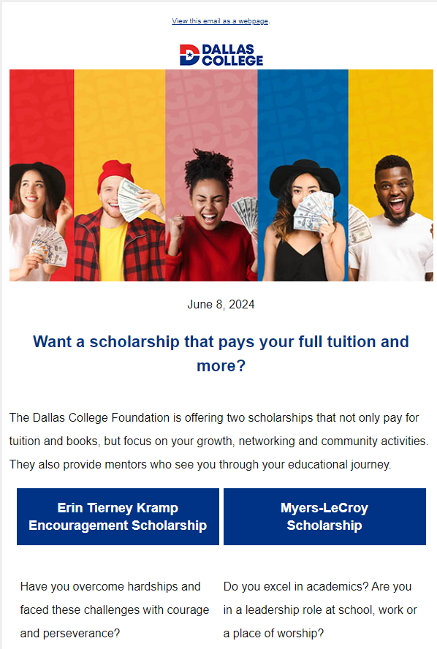
Top Open Rate This Year
99.7% Open Rate
Sent to 25,798
Subject line: Want a Free Education?
Only 3 bounces
Only 3 unsubscribes (.012%)
Only 495 people clicked (1.9% CTR)
Notes:
I don’t know the goal of the email … it was for two select scholarships but it makes me wonder if we should really count it as a success
The numbers suggest a lot of people saw it but either they didn’t care, didn’t think it was for them or didn’t understand the call to action – not sure

Slide 23
What Other Metrics Are There?

Slide 24
Click Through Rates (CTR)
Clicks
CTR is one of the easiest ways to track people taking action
Delivered Emails
Clicks / Delivered Emails = CTR

Slide 25
CTR By the Numbers
What’s your baseline for CTR?
All Users: 2.6%
Education: 4.3%

Slide 26
CTR Rates May Vary by List
Dallas Overall CTR Rates – 2.38%
Employees – 2.93%
Current Students – 2.41%
Student Services – 2.62%
Registration Emails – 4.6%
Automation Future Students – 7.37%
Jan. 1-June 2, 2024
Notes:
Pulling the last six months –
Overall open rates 29.69%
Overall CTR 3.41%
Employees – 21.26%; 2.92%
Current Students – 19.25%; 2.41% - includes our newsletters; we’ve seen a sizeable drop in the last 18 months when we switched to using Dallas College email addresses
Student Services – 25.61%; 2.62%
Registration – 35.78%; 4.6%
Automation Future Students – 65.77%; 7.37% - sending to roughly 1000 students a month

Slide 27
Optimize Your CTR
High CTR requires quality Call to Action (CTA)
Track Unique Clicks
Use Relevant CTAs
Create Urgency
Use Clear Call-to-Actions
Limit Your CTAs
Simplify Your Email Design
Clicks
Delivered Emails
Clicks / Delivered Emails = CTR

Slide 28
Bounce Rates
Bounce rates are a clear indication of how clean your data is
They will impact deliverability
Routine list cleaning is vital
Soft bounces – temporary failures (full inbox, server temporarily down)
Hard bounces – permanent errors (bad email, domain doesn’t exist)
Bounce
Delivered Emails
Bounce / Delivered Emails = Bounce Rates
Notes:
If email platforms see large number of bounces they’re more likely to label you as spam and will classify your emails accordingly Some systems will help you clean your list – Marketing Cloud will boot people after 3 hard bounces in 30 days.
If your system doesn’t automatically help you clean your list – figure out a plan to do so
Work with other areas of your college to ensure the data is corrected at the source

Slide 29
Unsubscribes
If they’re unsubscribing, they’re not buying what you’re selling
Why do you unsubscribe from emails?
Too many emails
Non-relevant content
Loss of interest
Spam
Notes:
Keep an eye on your unsubscribes. Anything more than

Slide 30
What We Should Focus On

Slide 31
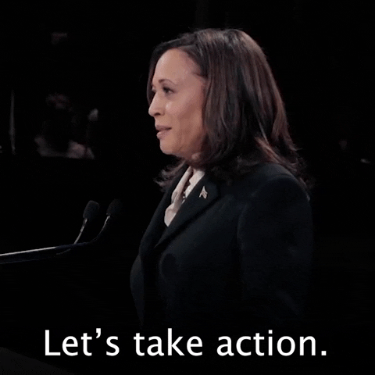
Conversion Rates
Did the person take an action?
Did we move the person further down the funnel?
Did they give us more information about themselves?
Regularly ask, are you ready to apply or unsubscribe?

Slide 32
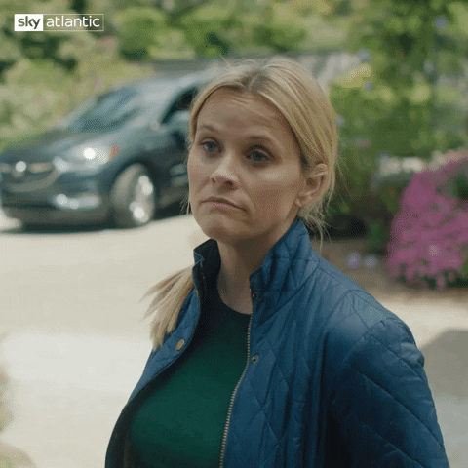
Conversions all Depend on Your Goals
What is the desired action you want your email recipient to take?
Align with your goals for the email or campaign

Slide 33
Possible Conversions
Download an infographic about FAFSA
Visit your website
Register for class
Sign up for an info session
Register for a campus tour
Sign up for orientation
Apply for college
Submit their application documents
Book an appointment with an advisor
Update their contact information

Slide 34
Examples
Top CTR last six months for students:
88.68% - Order Your Graduation Regalia
Several graduation emails were in the upper 80% CTR
Next Top CTR
Register for the Mental Health Symposium – 2.86%
Notes:
Keep an eye on your unsubscribes. Anything more than

Slide 35
Think Differently

Slide 36
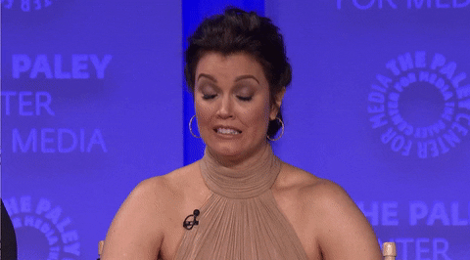
Old Thinking

Slide 37
Newer Thinking
Goal
Open Rate
Open Rate = 3%
Goal / Open Rate = List Size
300 / 3% = 10,000

Slide 38
Better Planning
Goal
CTR
Goal / CTR = List Size
300 Registrations / 2% = 15,000
Reverse: 15,000 (list) * 2% (CTR) = 300 responses
Notes:
Reverse this and say – I have 15,000 on my list – I have a 2% CTR so I can expect to get 300 people to respond to my email.

Slide 39
Level Up
1
2
Goal
Clicks Goal
Conv. Rate
CTR
Goal / Web Conversion Rate = Clicks Goal
Clicks Goal / CTR = List Size
Notes:
Determine how many people you need to take an action – (form completion, make a payment, register for an event)
Determine what your conversion rate on your web page is (the number of sessions / the event) – we average a 5% conversion rate on most of our web pages
Divide your web conversion rate by your goal … that’s how many people you need to visit your website
So now you know your goal for clicks – let’s say 300
Take your click goal / email CTR benchmark and that’s how big your list is
There’s no mention of open rates there … but now you can be strategic about what you need This is similar to if you’re figuring how many impressions you need on your digital ads. Just replace impressions with list size and you have the same idea.

Slide 40
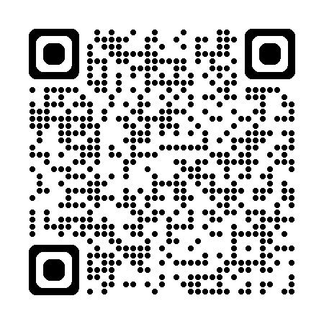
Level Up in Excel
How many people do you need? | What's your average conversion rate on your web page? | How many people need to come to the web page | What's your average email CTR | Your needed list size
300 | 5% | 6000 | 2% | 300,000
300 | 5% | 6000 | 7% | 85,7144
jdblundell.github.io/beyond-open-rates
Notes:
Determine how many people you need to take an action – (form completion, make a payment, register for an event)
Determine what your conversion rate on your web page is (the number of sessions / the event) – we average a 5% conversion rate on most of our web pages
Divide your web conversion rate by your goal … that’s how many people you need to visit your website
So now you know your goal for clicks – let’s say 300
Take your click goal / email CTR benchmark and that’s how big your list is
There’s no mention of open rates there … but now you can be strategic about what you need This is similar to if you’re figuring how many impressions you need on your digital ads. Just replace impressions with list size and you have the same idea.

Slide 41
Event Case Study
Partner was planning for 300 people to a series of events
They sent an email to 12,159 people
49% open rate (5,957 opens)
Only 1.5% CTR (182 clicks)
With a 5% CTR they could have met their goal
OR if they started with a list of 20,000

Slide 42
Alumni Case Study
Our alumni office is hosting more events for alumni
Their list is 76k
After unsubscribes, their list is now at 66k
With bounces, their list is down to 59k each send
Had a high of 8.56% last year, down to .63% on the last send
Average Open Rate is 42.46% (above average)
Average CTR is only .5% (roughly 2,950)
Switching to a newsletter format open rates dropped from 43.3% to 38.3% and CTR dropped from .53% to .39%
Notes:
Luckily thanks to our system cleaning the list the bounce rate is down to .63% on the last send
Because of their massive size - .5% is not great but for an event that’s more than needed if those people complete the form

Slide 43
Optimize Even More
Personalize and target
Use Litmus or similar tools to preview your emails
Ensure your emails work on mobile and dark mode
Write compelling subject lines and copy

Slide 44
Leverage Data and Analytics
Always ask “What is the goal of this email?”
Build reports and report out
Measure your metrics
Use UTMs to track success with your website
Get buy-in from the college to report back their information (attendance, etc)

Slide 45
2023 Automation Campaign
July 1, 2023 – Dec. 31, 2023
2,351 users to website
4,159 sessions
365 people clicked to the online admissions app
Notes:
Keep an eye on your unsubscribes. Anything more than

Slide 46
2024 Automation Campaign
Jan 1, 2024 – June 7, 2024
2,842 users to website (20.8% increase)
5,219 sessions (25.4% increase)
595 people clicked to the online admissions app (63% increase)
Notes:
Keep an eye on your unsubscribes. Anything more than

Slide 47
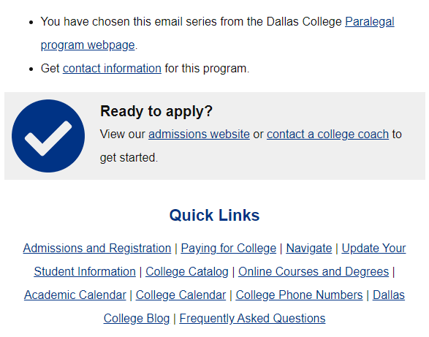
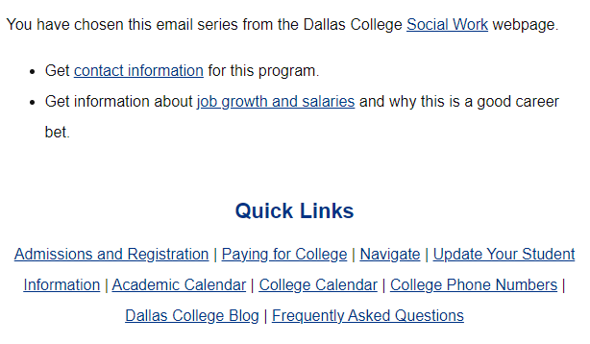
The Difference?
View our admissions website or contact a college coach to get started.
Notes:
The CTA is much larger and prominent. We also added links to our catalog and online courses and degrees. We’ll see if that continues to improve our numbers

Slide 48
Round Robin
What did I leave out?
What gaps can I fill?
What’s a success you’ve had with emails?

Slide 49
Download the Resources
jdblundell.github.io/beyond-open-rates

Slide 50
Current Trends
Hyper-personalization
Integrating email with other tools
Interactive email elements
Segmenting your customers into various lists
Mobile first
Automation
AI
Notes:
Personalization goes beyond just a name; send information that is specifically targeted to your audience
Let them subscribe to news/events about things they like
Give them personalized updates on their registration process
Integrate with other tools when you can to provide more data and personalization
I’m seeing more and more interactive elements from forms to videos. We’re not doing much of that yet because a lot of our users are using Outlook and so interactivity is limited.
Segmenting and targeting is key to be successful
Mobile first – only 30 characters of the subject line show up on iPhone … are you writing for those users?
I’m all on board with the automation train … the more I can build in advance and automate the more time I can spend on actually optimizing my campaigns
AI is going to continue to grow … Salesforce lets you use AI to analyze emails, find the best subject line and write content

